Slide 1
"Social Branding: How HR Can Help to Build Your Organization's Reputation with
Social Media"
Dmcgrath@hr.com for Slides
Register for Free and
Search on HR.com
Notes:
----- Meeting Notes (3/19/14 16:54) -----

Slide 2

Definition of Employment Brand
Employer brand denotes an organization's reputation as an employer.
Just as a customer brand proposition is used to define a product or service offer, an employee value proposition is used to define an organization's employment offer. Likewise the marketing disciplines associated with branding and brand management have been increasingly applied by the human resources and talent management community to attract, engage and retain talented candidates and employees, in the same way that marketing applies such tools to attracting and retaining clients, customers and consumers.

Slide 3
Areas HR Impacts / Control
Social Media Reach for Careers and Employees
Social Kudos and Recognitions
Training and Education
Awards and Programs – Recognition from others
Employment Videos
Messaging to Future Employees – Job Descriptions

Slide 4
Social Media Reach Essential
Channel Development - Different Audience different media – Facebook vs Linkedin vs Instagram vs SnapChat vs Whatsup vs Pinterest vs tomorrows hottest topics
Followers/ Friends: Let you showcase your expertise and build relationships or talent pipelines.
Dedicated Resources REQUIRED. You don’t get friends / followers without asking and compelling content
Notes:
How many people do you have running your employment Branding and social media ?
What’s Hot …

Slide 5
Social Media Reach Essential
All channels need multiple levels of work
Groups
Fanpages
Followers
Targeted Advertising
Content Stimulation
Notes:
How many people do you have running your employment Branding and social media ?

Slide 6
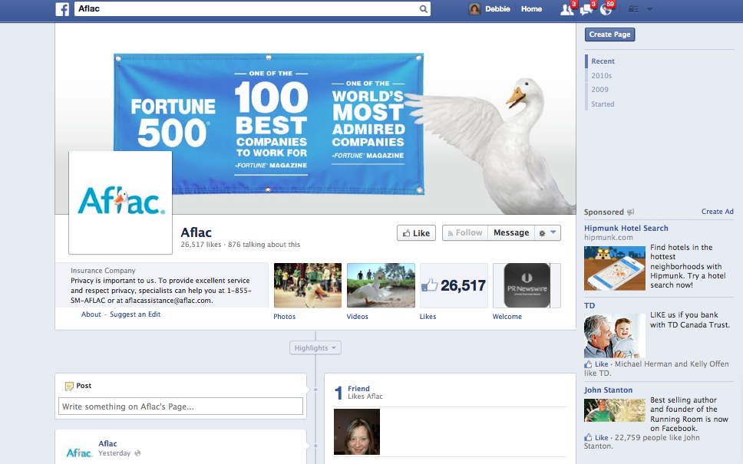
Videos – What's it like to work at your company
Twitter Nasa – 6 M
Starbucks 5.8M
Notes:
Has to maintain the voice of your organization

Slide 7
Social Kudos and Recognition
Enables all levels of staff to share and recognize.
People want recognition Money is not the top motivator.
People share these recognitions externally with friends and family
Verbally
On Social Media
In emails and much more
Notes:
Mike Abroshoff Story of Hand written notes to gfamily members.

Slide 8
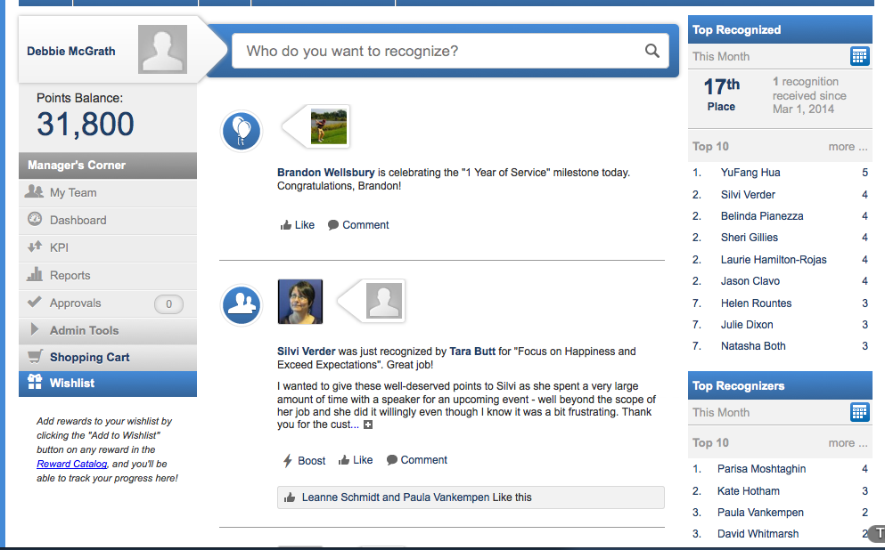
Social Recognition Programs

Slide 9


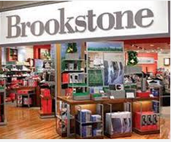

Training and Education

Slide 10
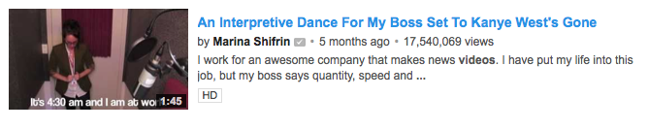
Videos – What’s it like to work at your company
Drive traffic to your Career Pages
Show case what it is really like to work at your organization
https://www.youtube.com/watch?v=Ew_tdY0V4Zo

Slide 11
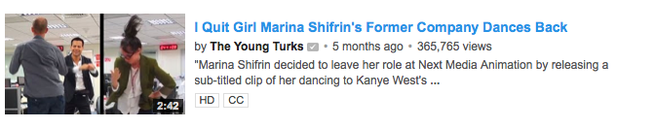
Videos – Be Provocative, Be funny and Be quirky
https://www.youtube.com/watch?v=OeTmjnpj0Lw

Slide 12
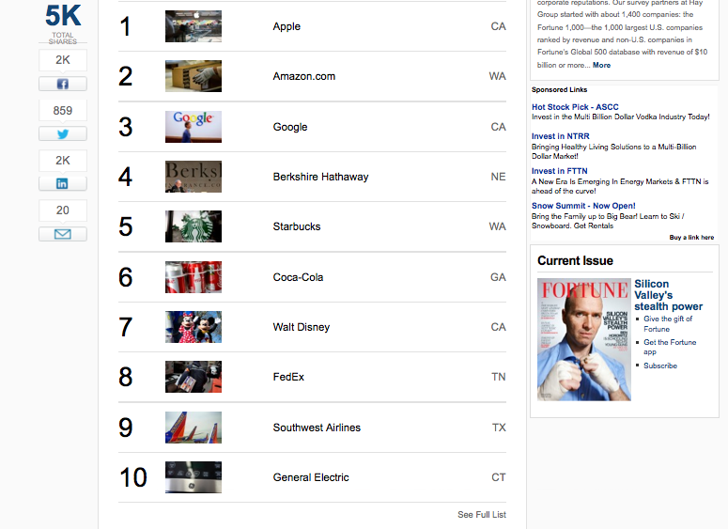
Recognition and Awards Programs
National “Best Places to Work Competitions “
Local Newspaper / Crain Sponsored Programs
Achievers Most engaged Employers
HR.com Leadership500 Program
ASTD Leadership Programs
Tips : Most programs have a hard time getting entries

Slide 13
Awards and Recognition Plans
National Programs – Fortune, Fast Company, ASTD, HR.com, SHRM Small Business
Local Programs – Crains , Local Papers, Chamber Programs,
Tip : Many of these programs have a hard time getting applicants because WE always think we are not the “Best Place to WORK”
Apply EVERY where you can

Slide 14
Future Employee Communication
Candidate Experience is essential
Build a Manifesto
Enticing Job Descriptions need to focus on the values of the organization

Slide 15
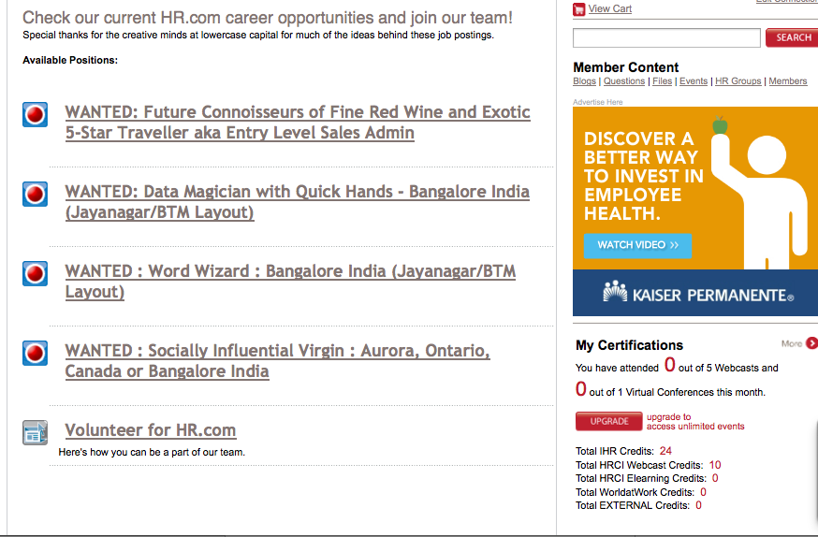
Future Employee Communication
Notes:
Mike Abroshoff Story of Hand written notes to family members.

Slide 16
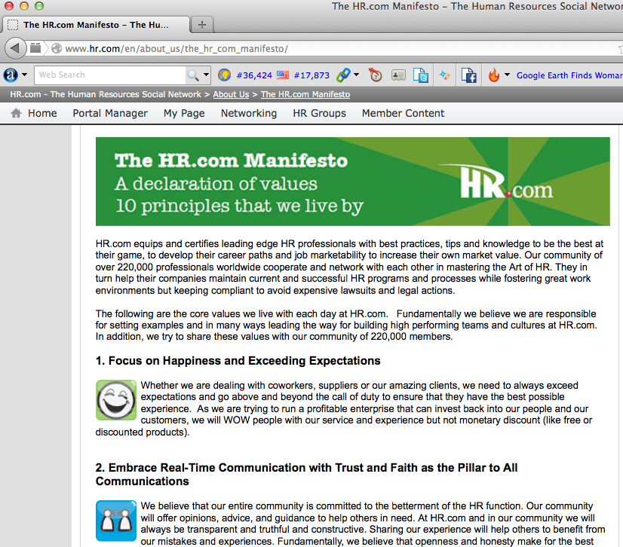
Future Employee Communication

Slide 17
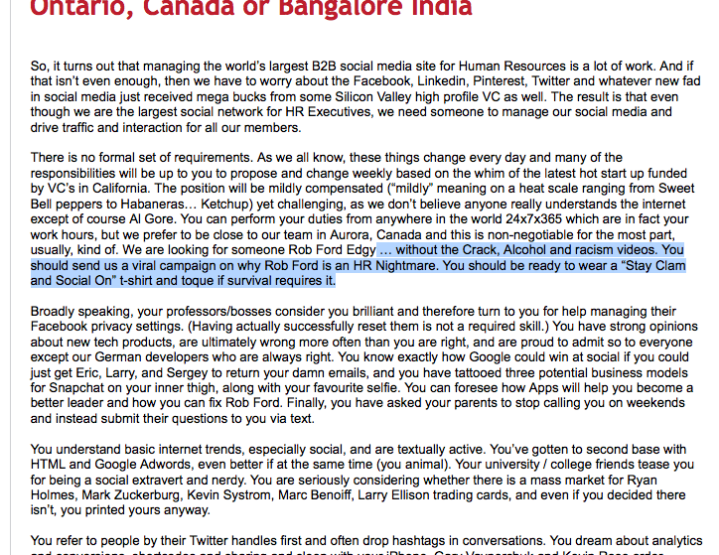
Future Employee Communication

Slide 18
Employment Brand
Easy to create … Hard to enforce and had to live by
Appoint a brand ambassador

Slide 19
For more information
HR.com
Debbie McGrath
905 727 1340 x 104
dmcgrath@hr.com
Slides on HR.com for free
Search Hrstar2014

